Slide 1



Praktična delavnica Docker & Kubernetes
September 2021
www.ict-academy.eu

Slide 2

Urnik 21. 9.
08:30 – 15:30
Docker
Urnik 22. 9.
08:30 – 15:30
Kubernetes
www.ict-academy.eu

Slide 3
AVTORSKE PRAVICE GRADIVA
Vsa gradiva usposabljanja Docker & Kubernetes, september 2020 (predavanja, demonstracije, vaje), so last Univerze v Ljubljani, Fakultete za elektrotehniko (UL FE).
Uporaba je dovoljena izključno v okviru usposabljanja.
Noben del gradiva ne sme biti reproduciran, shranjen ali prepisan v katerikoli obliki oziroma na katerikoli način (elektronsko, mehansko, s fotokopiranjem, snemanjem) brez predhodnega pisnega dovoljenja.
Vse pravice pridržane. © september 2020, UL FE.

Slide 4

UL Fakulteta za elektrotehniko
2.200+ študentov
300+ raziskovalcev in akademskega osebja
50 % sredstev pridobljenih na trgu

Slide 5


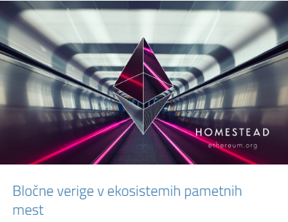
Laboratorij za telekomunikacije Laboratorij za multimedijo

Slide 6

Najdete nas tudi na:

Slide 7
Področja uporabe IKT/IoT
2010
Networks, Telecommunications, ICT
2020
eHealth and Wellbeing
Industry 4.0
Public safety
Innovations
...
ICT
...
ICT
ICT
ICT
Transport
Education and Training
Energy
Turism
ICT
ICT
ICT
ICT

Slide 8







Aktivnosti (1)
Usposabljanja za podjetja in organizacije
IKT-akademija, IoT-akademija, Digitalna akademija
Multimedijsko podprto učenje, E-Cho
Prototipiranje, Makerlab/Openlab/FabLab
Rešitve IKT/IoT za različna področja
AR/VR/360º za športne dogodke in dostopnost
Odprto inoviranje: Pametno ogledalo, Gnezdo, SmartFroc
Digitalno inovacijsko stičišče
Sodelovanje in povezovanje s študenti

Slide 9







Aktivnosti (2)
Pilotne in demonstracijske rešitve
Rešitve za pametna mesta in vasi
112 aplikacije (4G/5G/VR)
IoT in omrežja za ceste
Blockchain IoT in PoE
Kibernetska varnost; honeypoti ter analitika vdorov
Razvojni projekti
Signalizacije in kontrolna ravnina
Smartgrid komunikacije in IoT
Testiranje omrežij
Vsebine AR/VR, 360º

Slide 10
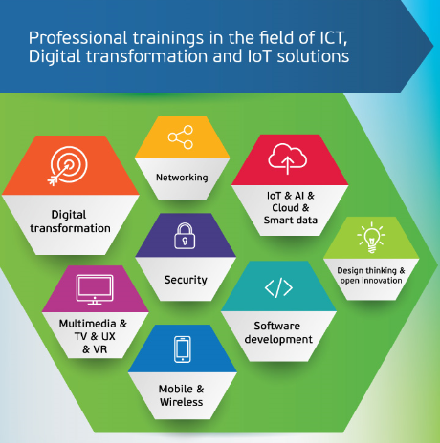

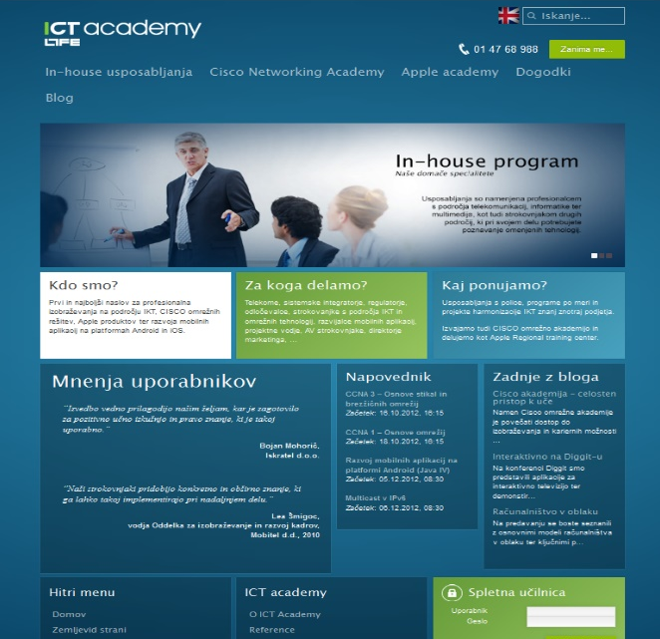
www.ict-academy.eu

Slide 11

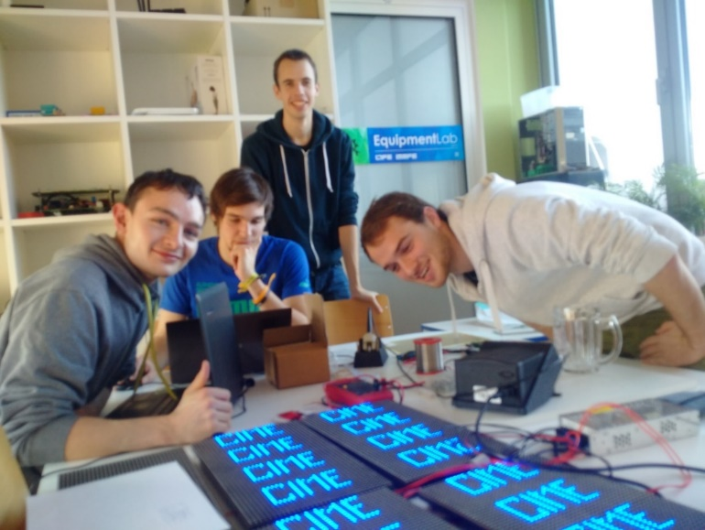
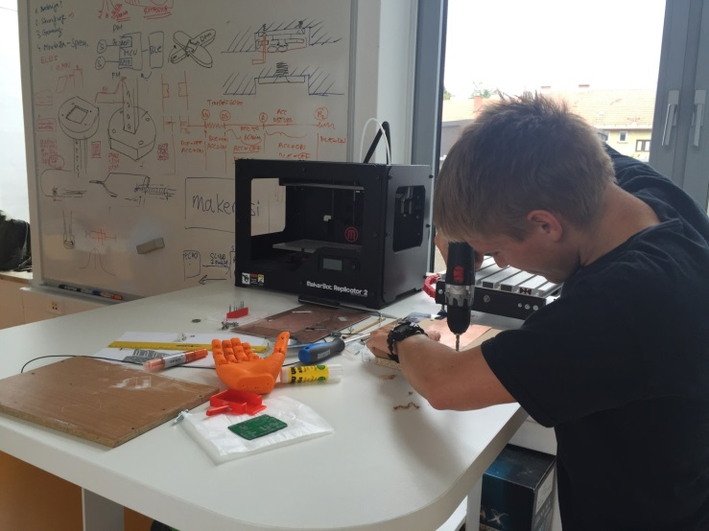
Prototipiranje, MakerLab
Poudarek na IoT
Razvoj, inovacije
Learning by doing

Slide 12
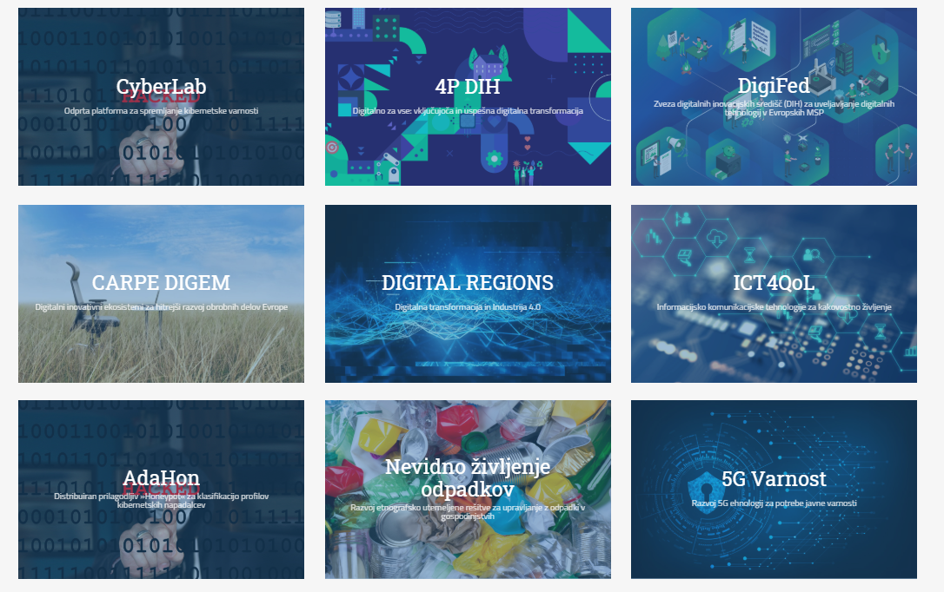
Pilotne in demonstracijske rešitve, R&D

Slide 13
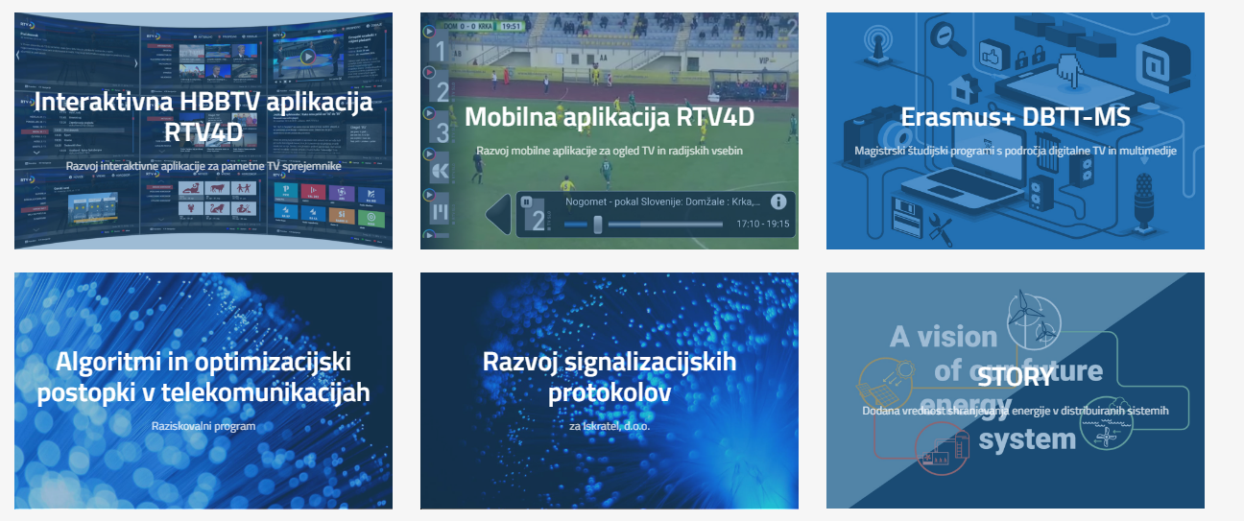

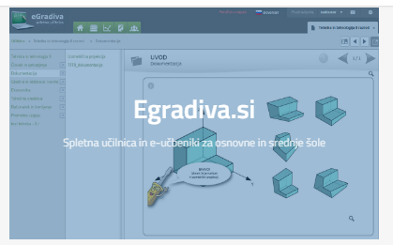
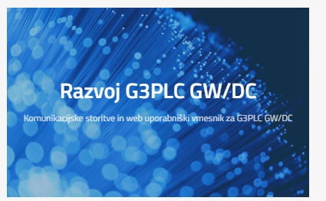
Razvojni projekti

Slide 14
Predpriprava
Predpripravljena virtualka
Prenesemo gradiva iz Git-a:
git clone https://github.com/leon11s/docker-k8s-public.git

Slide 15

Cloud-Native Architectures and Technologies
Ljubljana, september 2021

Slide 16
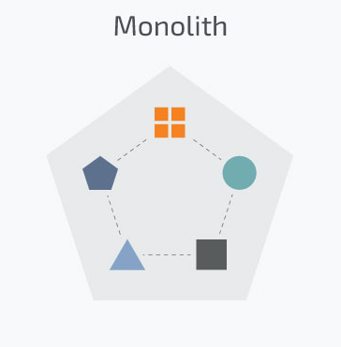
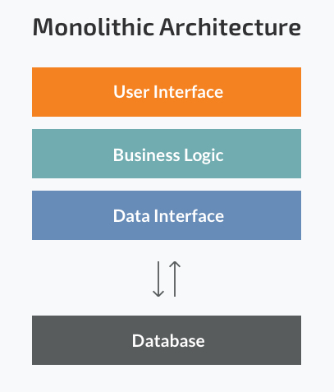
Traditional applications
Monolithic application
Years ago, most software applications were big monoliths
Built as a single and indivisible unit
Still widespread today
Challenges
Handling a huge code base
Adopting a new technology
Scaling
Lack of modularity
Deployment
Implementing new changes -> slow (entire application has to be rewritten)
Source: Microservices vs Monolith: which architecture is the best choice for your business? https://www.n-ix.com/microservices-vs-monolith-which-architecture-best-choice-your-business/

Slide 17
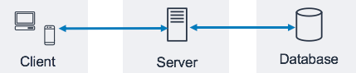
Client-side user interface, a server side-application, and a database.
Strengths
Less cross-cutting concerns (logging, handling, caching, and performance monitoring)
Easier debugging and testing
Simple to deploy (just one file or directory)
Simple to develop (knowledge – standard way of development)
MonolithFirst
Source: Three-Tier Architecture Overview - https://docs.aws.amazon.com/whitepapers/latest/serverless-multi-tier-architectures-api-gateway-lambda/three-tier-architecture-overview.html
Notes:
Strengths of the Monolithic Architecture
- Less cross-cutting concerns. Cross-cutting concerns are the concerns that affect the whole application such as logging, handling, caching, and performance monitoring. In a monolithic application, this area of functionality concerns only one application so it is easier to handle it.
- Easier debugging and testing. In contrast to the microservices architecture, monolithic applications are much easier to debug and test. Since a monolithic app is a single indivisible unit, you can run end-to-end testing much faster.
- Simple to deploy. Another advantage associated with the simplicity of monolithic apps is easier deployment. When it comes to monolithic applications, you do not have to handle many deployments – just one file or directory.
- Simple to develop. As long as the monolithic approach is a standard way of building applications, any engineering team has the right knowledge and capabilities to develop a monolithic application.

Slide 18
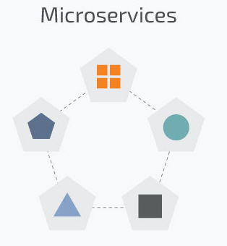
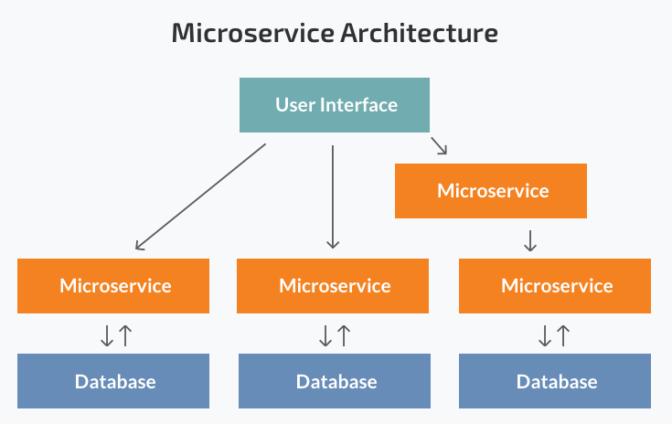
Microservices
Today, these big monolithic legacy applications are slowly being broken down into smaller, independently running components called microservices.
Source: Microservices vs Monolith: which architecture is the best choice for your business? https://www.n-ix.com/microservices-vs-monolith-which-architecture-best-choice-your-business/

Slide 19
These units carry out every application process as a separate service.
So all the services have their own logic and the database.
Components communicate with each other through defined methods called APIs.
Strengths:
Independent components
Easier understanding
Better scalability
Flexibility in choosing the technology
The higher level of agility
Weaknesses:
Extra complexity
System distribution
Cross-cutting concerns (configuration, logging, metrics, health checks)
Testing

Slide 20
Scaling monolithic apps
Running a monolithic application usually requires a small number of powerful servers that can provide enough resources for running the application.
To deal with increasing loads on the system:
vertically scale the servers (also known as scaling up) -> adding more CPUs, memory, and other server components
usually doesn’t require any changes to the app
gets expensive relatively quickly
in practice always has an upper limit
scale the whole system horizontally (scaling out) -> setting up additional servers and running multiple copies of an application
relatively cheap hardware-wise
require big changes in the application code (sometimes impossible)

Slide 21
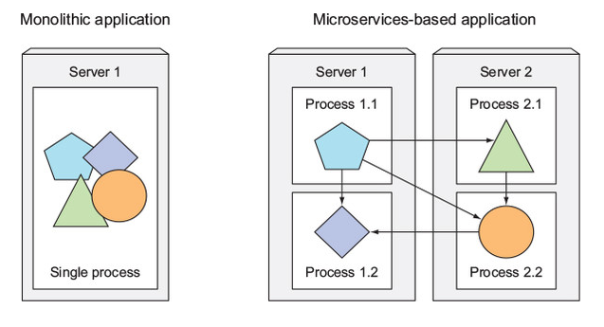
Splitting apps into microservices
Described problems have forced us to start splitting complex monolithic applications into smaller independently deployable components called microservices.
Each microservice:
runs as an independent process,
communicates with other microservices through simple, well-defined interfaces (APIs)
can be written in the language that’s most appropriate for implementing that specific microservice
Source: Marko Luksa - Kubernetes in Action-Manning Publications (2018)

Slide 22
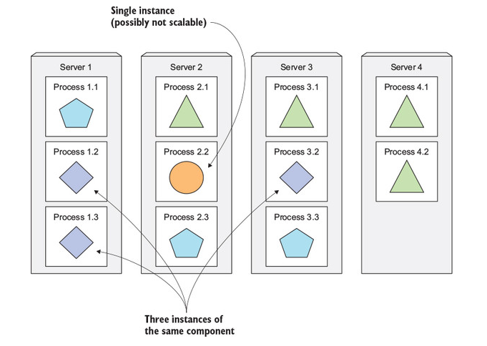
Scaling microservices
Scaling is done on a per-service basis.
you have the option of scaling only those services that require more resources
Splitting the app into microservices allows you to horizontally scale the parts that allow scaling out
Source: Marko Luksa - Kubernetes in Action-Manning Publications (2018)

Slide 23
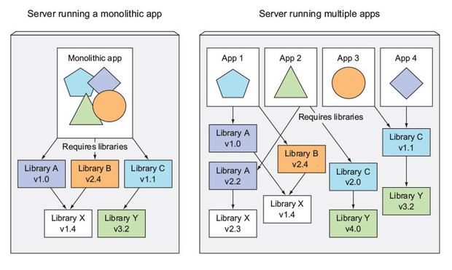
Microservices environment requirements
Components in a microservices architecture are also developed independently
common to have separate teams developing each component
different libraries and different versions of the same libraries
exact same environment during development, testing and in production -> container technologies
Source: Marko Luksa - Kubernetes in Action-Manning Publications (2018)

Slide 24
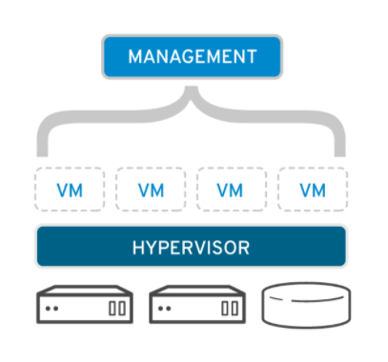
Virtualizacija
Virtualizacija omogoča transformacijo hardwarea v software.
Ustvarimo popolnoma delujoč računalnik, ki lahko poganja svoje aplikacije in operacijski sistem
Uporabimo virtualen CPU, RAM in disk, ki je iz vidika sistema enak fizičnemu
Vir: https://www.redhat.com/en/topics/virtualization
Notes:
Vir slike: https://www.redhat.com/en/topics/virtualization
Virtualization transforms hardware into software.
It is the creation of a fully functional virtual computer that can run its own applications and an operating system.
Creates virtual elements of the CPU, RAM, and hard disk.

Slide 25
Virtualizacija - motivacija
Hardware je vedno cenejši in močnejši -> vedno bolj zahtevne aplikacije
Neizkoriščene zmogljivosti
Prostor v strežniških omarah je drag
Varovanje okolja
Zamudne in drage upravne naloge
Monitoring strojne opreme
Menjava pokvarjene opreme brez prekinitve delovanja sistema
Inštalacija in nadgradnje strežnikov so zahtevne
Backup
Notes:
Increased performance and computing capacity relevance to hardware manufacturing. • Underutilized Hardware and software Resources • Lack of Space • Greening Initiatives • Rise of administrative costs • Administrative tasks include: labor intensive • hardware monitoring • defective hardware replacement • server setup and updates • resource monitoring backups

Slide 26
Containers
Different software components require different environment requirements
Components start getting smaller, their numbers start to grow -> can’t give each of them their own VM
VM usually needs to be configured and managed individually
Linux container technology provide isolation for running applications
A process running in a container runs inside the host’s operating system
The process in the container is still isolated from other processes
Examples: FreeBSD Jails, Solaris Zones, Docker containers

Slide 27
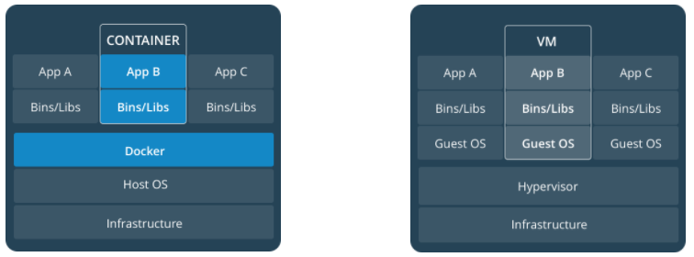
Containers are lightweight because they don’t need the extra load of a hypervisor, but run directly within the host machine’s kernel.
A container runs natively on Linux and shares the kernel of the host machine with other containers.
It runs a discrete process, taking no more memory than any other executable, making it lightweight.
Source: https://docs.docker.com/get-started/

Slide 28
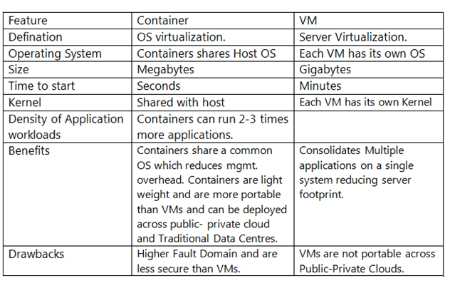
Source: https://mykloud.wordpress.com/2018/06/06/containers-deep-dive/

Slide 29
Docker
Ljubljana, september 2021

Slide 30
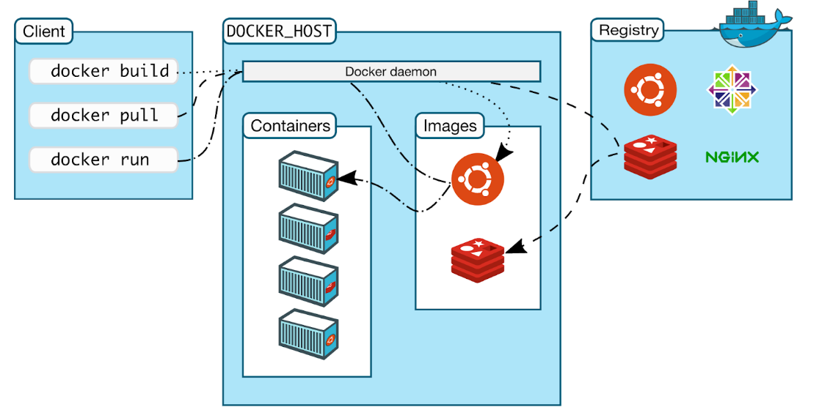
Docker
Docker is an open platform for developing, shipping, and running applications.
Docker is a command-line program, a background daemon, and a set of remote services for simplifying your experience installing, running, publishing, and removing containers.
Source: https://docs.docker.com/get-started/overview/

Slide 31
Zakaj Docker?
Hiter in konsistenten razvoj aplikaciji
Odzivna namestitev in skaliranje
Zagon več aplikaciji na isti strojni opremi
Zmanjšuje nekonsistentnost razvojnih in produkcijskih okolij
Zagotavlja neodvisnost od platform in programskih jezikov
Omogoča gradnjo aplikacij s kompozicijo mikrostoritev
Notes:
- You can even run Docker containers within host machines that are actually virtual machines!

Slide 32
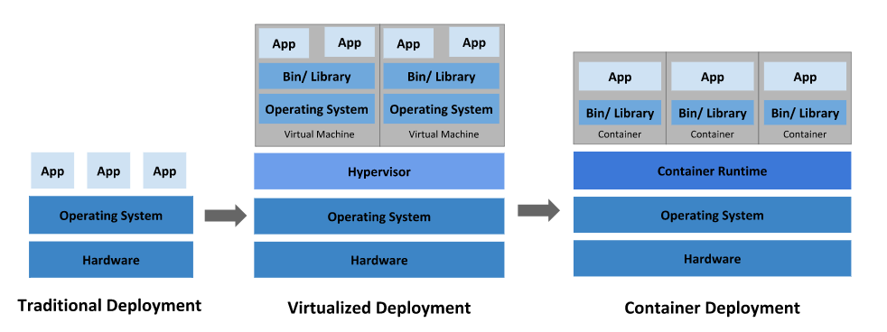
History overview
Source: https://kubernetes.io/docs/concepts/overview/what-is-kubernetes/
Container-as-a service (CaaS) is expected to replace VM-based infrastructure-as-a-service (IaaS) cloud technologies (such as OpenStack) over the next decade.
Notes:
Traditional deployment era: Early on, organizations ran applications on physical servers. There was no way to define resource boundaries for applications in a physical server, and this caused resource allocation issues. For example, if multiple applications run on a physical server, there can be instances where one application would take up most of the resources, and as a result, the other applications would underperform. A solution for this would be to run each application on a different physical server. But this did not scale as resources were underutilized, and it was expensive for organizations to maintain many physical servers.
Virtualized deployment era: As a solution, virtualization was introduced. It allows you to run multiple Virtual Machines (VMs) on a single physical server's CPU. Virtualization allows applications to be isolated between VMs and provides a level of security as the information of one application cannot be freely accessed by another application. Virtualization allows better utilization of resources in a physical server and allows better scalability because an application can be added or updated easily, reduces hardware costs, and much more. With virtualization you can present a set of physical resources as a cluster of disposable virtual machines. Each VM is a full machine running all the components, including its own operating system, on top of the virtualized hardware.
Container deployment era: Containers are similar to VMs, but they have relaxed isolation properties to share the Operating System (OS) among the applications. Therefore, containers are considered lightweight. Similar to a VM, a container has its own filesystem, share of CPU, memory, process space, and more. As they are decoupled from the underlying infrastructure, they are portable across clouds and OS distributions.

Slide 33
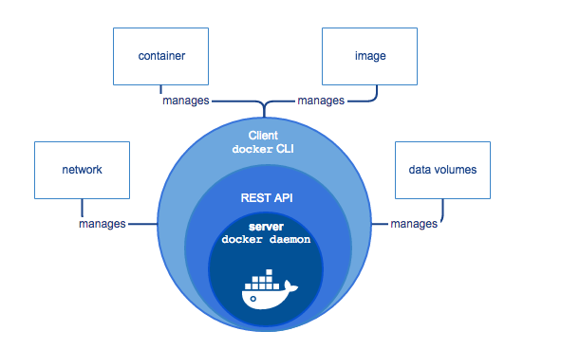
Docker Engine
Docker Engine is a client-server application with these major components:
A server which is a type of long-running program called a daemon process (the dockerd command).
A REST API which specifies interfaces that programs can use to talk to the daemon and instruct it what to do.
A command line interface (CLI) client (the docker command).
Source: https://docs.docker.com/get-started/overview

Slide 34
Docker architecture
The Docker client talks to the Docker daemon, which does the heavy lifting of building, running, and distributing your Docker containers.
The Docker client and daemon can run on the same system, or you can connect a Docker client to a remote Docker daemon.
The Docker client and daemon communicate using a REST API, over UNIX sockets or a network interface.
A Docker registry stores Docker images. Docker Hub is a public registry that anyone can use.

Slide 35
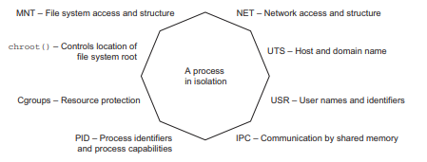
Docker is written in the Go programming language.
Docker uses:
Linux namespaces: makes sure each process sees its own personal view of the system (files, processes, network interfaces, hostname)
Cgroups: limit the amount of resources the process can consume (CPU, memory, network bandwidth)
Union file systems
Source: Source: Docker in action - JEFF NICKOLOFF

Slide 36
Docker - namestitev
Za večino operacijskih sistemov
Navodila najdemo na: https://docs.docker.com/engine/install/
Post-installation steps for Linux
https://docs.docker.com/engine/install/linux-postinstall/
Manage Docker as a non-root user
Configure Docker to start on boot

Slide 37
Preizkus delovanja
Test Docker version
$ docker version
Test Docker installation
$ docker run hello-world
$ docker image ls
$ docker ps –all
$ docker rm $(sudo docker ps -aq)

Slide 38
Docker kontejnerji
Docker omogoča izvajanje aplikacij v varnostno izoliranih vsebnikih.
Varnost in izolacija omogočata izvajanje več vsebnikov na istem gostitelju.
Posledično je izraba strojne opreme bolj optimalna.
Vsebnik vsebuje vse kar aplikacija potrebuje za svoje izvajanje in je zgrajen na osnovi Docker slike.
Vsebnike lahko zaganjamo, ugašamo, premikamo in brišemo.
Vsebniki predstavljajo izvajalno komponento Dockerja

Slide 39
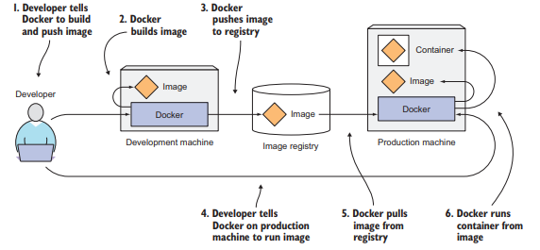
Docker Image
A Docker-based container image is something you package your application and its environment into.
It contains the filesystem that will be available to the application and other metadata, such as the path to the executable that should be executed when the image is run.
Source: Marko Luksa - Kubernetes in Action-Manning Publications (2018)

Slide 40
Docker slike so read only predloge iz katerih se zaganjajo vsebniki.
Vsaka slika sestoji iz zaporedja nivojev (nivojev slik), ki jih Docker s pomočjo Unionfs skombinira v eno sliko.
Unionfs omogoča transparentno združevanje datotek in direktorijev več datotečnih sistemov v en skladen datotečni sistem.
Nivoji predstavljajo en razlog zakaj Docker velja za lahkotno rešitev spremembe kot dodajanje aplikacije zajema le gradnjo enega novega nivoja.
Distribucija slike zahteva le prenos nivojev, ki so bili na novo dodani ali spremenjeni.

Slide 41
Vse slike bazirajo na osnovnih slikah (base image), npr.: ubuntu , fedora, centos
Novo sliko gradimo na podlagi osnovnih slik z uporabo opisnih direktiv instructions. Vsaka direktiva v sliki ustvari nov nivo.

Slide 42
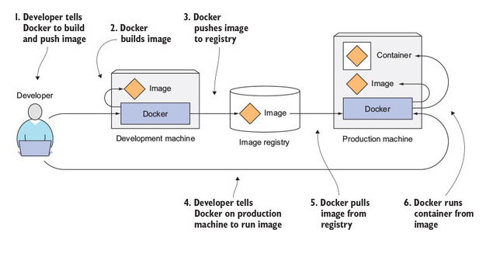
Vir: Marko Luksa - Kubernetes in Action-Manning Publications (2018)

Slide 43
Zagon Docker kontejnerja
Vsebnik je sestavljen iz OS, datotek dodanih iz strani uporabnika in metapodatkov.
Ob zagonu vsebnika Docker na read only nivoje, definirane v sliki, doda read write nivo v katerem se izvaja aplikacija.
Ob zagonu vsebnika se izvede:
Prenos slike (pull): preveri če obstaja lokalno, drugače prenese iz Docker Hub (ali privatnega repozitorija)
Na osnovi slike ustvari nov vsebnik
Alocira datotečni sistem in priklopi read write nivo.
Alocira omrežni / bridge vmesnik.
Dodeli IP naslov.
Zažene specificiran proces.
Zajema izhod aplikacije.

Slide 44
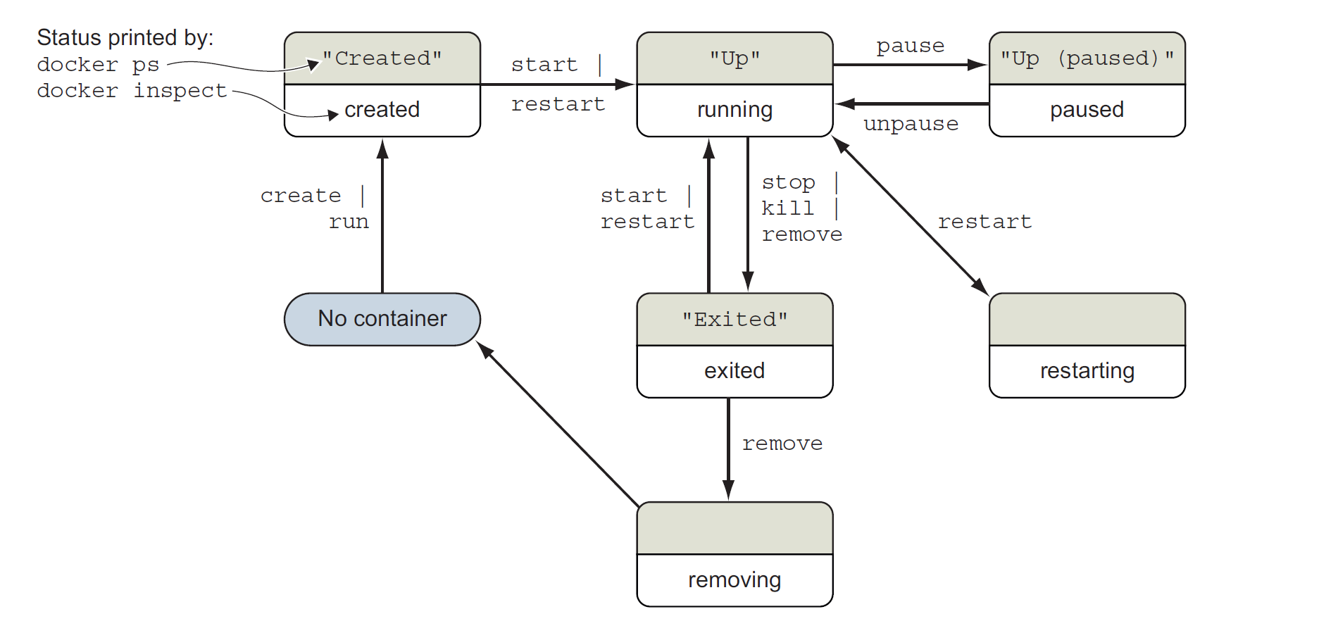

Slide 45
Uporabni ukazi
# kill all running containers
docker kill $(docker ps -q)
# remove all running containers
docker rm $(docker ps -a -q)
# remove all images
docker rmi $(docker images -q)

Slide 46
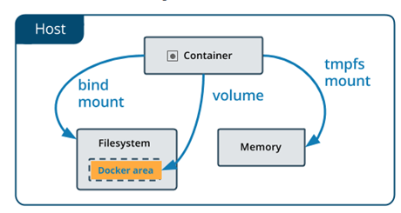
Trajno shranjevanje podatkov – Volumes
https://docs.docker.com/storage/
Poznamo 3 načine kako lahko vpnemo prostor za shrnajevanje v kontejner:
Bind mounts
In-memory storage
Docker volumes

Slide 47
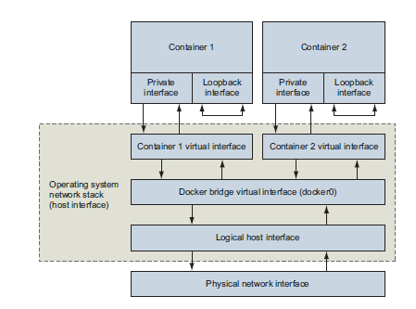
Orežne nastavitve
Bridge network
Host network
None network

Slide 48
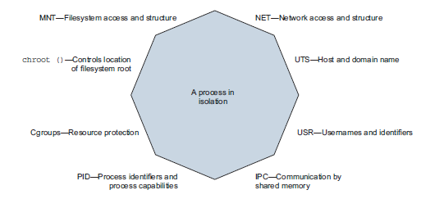
Upravljanje z viri
Kontejnerji ponujajo izolirane procese, ne pa celotna sistemske virtualizacije
Želimo omejiti tveganja zagnanih aplikaciji

Slide 49
Gradnja slik (create an image)
Razlogi:
Za programsko opremo, ki jo potrebujemo, še ne obstaja Docker slika
Funkcija, ki jo potrebujemo ni na voljo v obstoječi sliki
Kako?
Prilagodimo obstoječo sliko znotraj kontejnerja
Uporabimo skripto imenovano Dockerfile

Slide 50
Union file systems
Union mount - več map po sistemu navidezno združimo v eno, ki ima vsebino vseh
UFS dela podobno, a s celotnim datotečnim sistemom.
Vsak predstavlja majhen, a samostojen del
Vsak se lahko ločeno prenaša in shranjuje
Vsak se lahko ponovno uporabi in združi v različne kombinacije
Pri Dockerju je vsak sloj svoj datotečni sistem
Primer: Datotečni sistem na vašem računalniku gledamo kot unijo osnovnega sistema (default Windows 10) in vseh vaših datotek, programov, …. Če vsi delamo backup računalnikov bo prvi sistem pri vseh enak in ga lahko shranimo samo enkrat.

Slide 51
Gradnja slik iz Docker kontejnerja
Building Docker images from a container
union filesystem mount (UFS) -> omogoči vpenjanje datotečnega sistema kontejnerja
Vsaka sprememba, ki jo naredimo v datotečnem sistemu znotraj kontejnerja, bo postala nov sloj v kontejnerju
Postopek:
Ustvarimo kontejner iz obstoječe slike
Spremenimo datotečni sistem kontejnerja
Shranimo (commit) ustvarjene spremembe
Notes:
- https://www.scalyr.com/blog/create-docker-image/

Slide 52
Gradnja slik z datoteko Dockerfile
Dockerfile reference
Tekstovna datoteka, ki vsebuje navodila za ustvarjanje Docker slike
Izvaja se od zgoraj navzdol
Uporablja enostavne enovrstične ukaze
Najpogostejši način kako opišemo gradnjo Docker slike
Enostavno spremljanje sprememb v git-u
Omogoča komentiranje za lažje razumevanje
Datoteka .dockerignore
Datoteka pogosto poimenovana Dockerfile, vendar lahko ima poljubno ime
Notes:
https://docs.docker.com/engine/reference/builder/

Slide 53
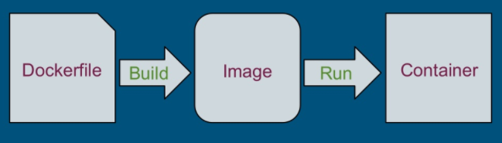
Notes:
Vir slike: https://training.play-with-docker.com/microservice-orchestration/

Slide 54
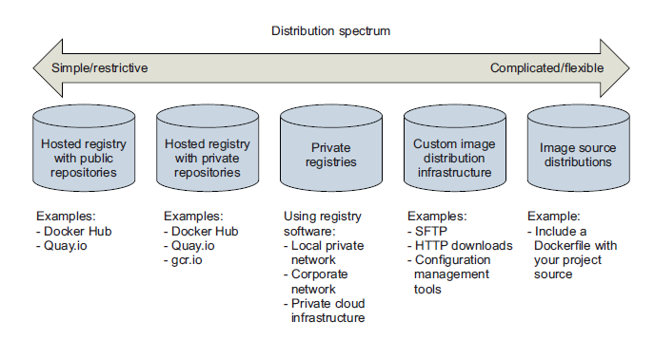
Distribucija Docker slik

Slide 55
Dockerfile
FROM
RUN
CMD
LABEL
MAINTAINER (deprecated)
EXPOSE
ENV
ADD
COPY
ENTRYPOINT
VOLUME
USER
WORKDIR
ARG
ONBUILD
STOPSIGNAL
HEALTHCHECK
SHELL

Slide 56
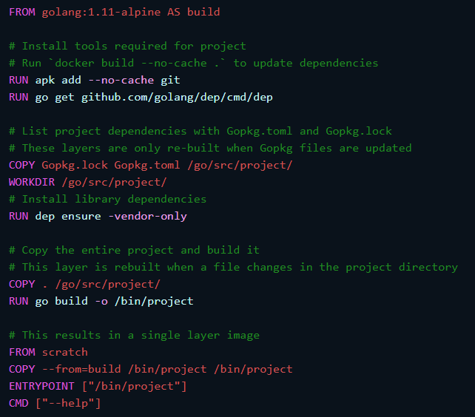

Slide 57
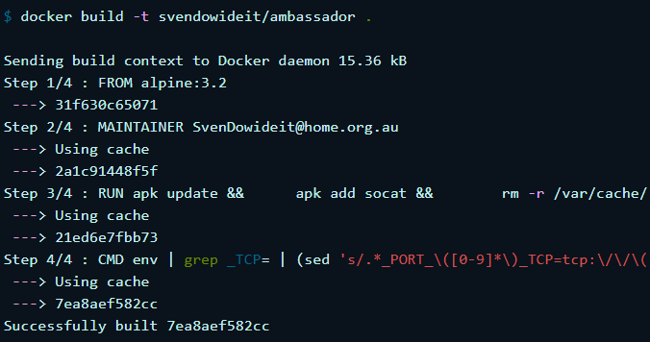

Slide 58
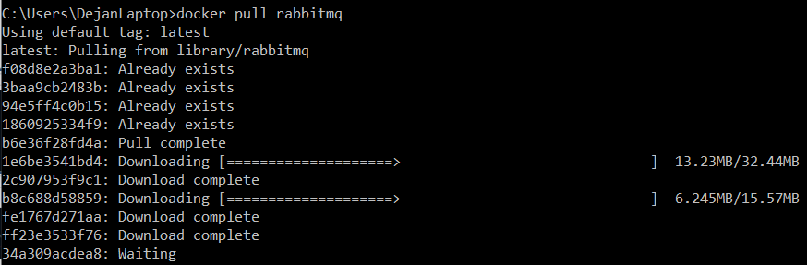

Slide 59
Kaj bi se zgodilo, če bi nameščali razne mikrostoritve, ki bi bile napisane v Javi, JavaScript, Python, …? Skoraj vse sloje bi si delile in namestitev bi bila zelo hitra.

Slide 60
Command: docker image build
Usage: docker image build [OPTIONS] PATH | URL | -
Description: Build an image from a Dockerfile
--file , -f |  | Name of the Dockerfile (Default is ‘PATH/Dockerfile’)
--tag , -t |  | Name and optionally a tag in the ‘name:tag’ format
--rm | true | Remove intermediate containers after a successful build
--no-cache |  | Do not use cache when building the image
Notes:
https://docs.docker.com/engine/reference/commandline/image_build/

Slide 61
Dockerfile – dobre prakse
Create ephemeral containers
Understand build context
Exclude with .dockerignore
Use multi-stage builds
Don’t install unnecessary packages
Decouple applications (Package a single app per container)
Minimize the number of layers
Sort multi-line arguments
Leverage build cache
Insecure: However, it also means you won’t get security updates for system packages. So you also need to regularly rebuild the image from scratch.
Notes:
https://cloud.google.com/solutions/best-practices-for-building-containers
https://pythonspeed.com/articles/official-docker-best-practices/

Slide 62
FROM: should have a tag and it shouldn't be latest
RUN: apt / yum: installed packages should have a version
FROM: every image should be pulled from the organization's private registry
USER property should be specified, and it should not be root
So don’t bind to ports <1024, and do run as a non-privileged user.
LABEL property should exist

Slide 63
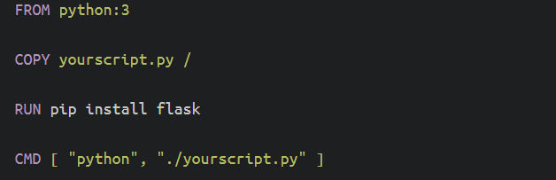
Primer - Python

Slide 64
Python – primer: dobre prakse
Non-reproducible builds re Python version
Non-reproducible builds re dependencies: Create requirements.txt with transitively-pinned versions of all dependencies
Changes to source code invalidate the build cache
Running as root, which is insecure
You probably don’t want to use Alpine Linux
Is leading to slower builds, larger images, and obscure bugs.
Use the official images based on Debian Buster.
https://hub.docker.com/_/python
Notes:
https://pythonspeed.com/articles/dockerizing-python-is-hard/
https://pythonspeed.com/articles/base-image-python-docker-images/

Slide 65
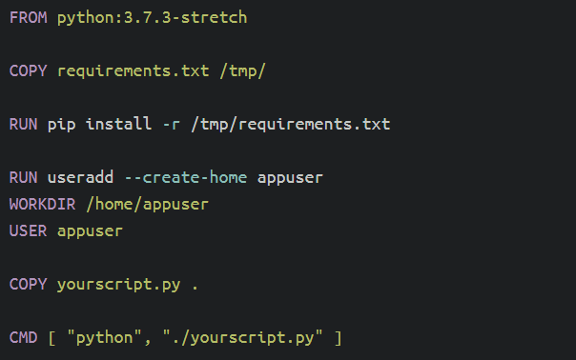

Slide 66
Docker Compose
Omogoča in poenostavlja zagon aplikacij sestavljenih iz več kontejnerjev.
Ko zgradimo slike posameznega vsebnika moramo definirati datoteko s storitvami (docker-compose.yaml)
Uporabno če so med vsebniki odvisnosti npr.: podatkovna baza mora biti dostopna pred zagonom aplikacije.

Slide 67
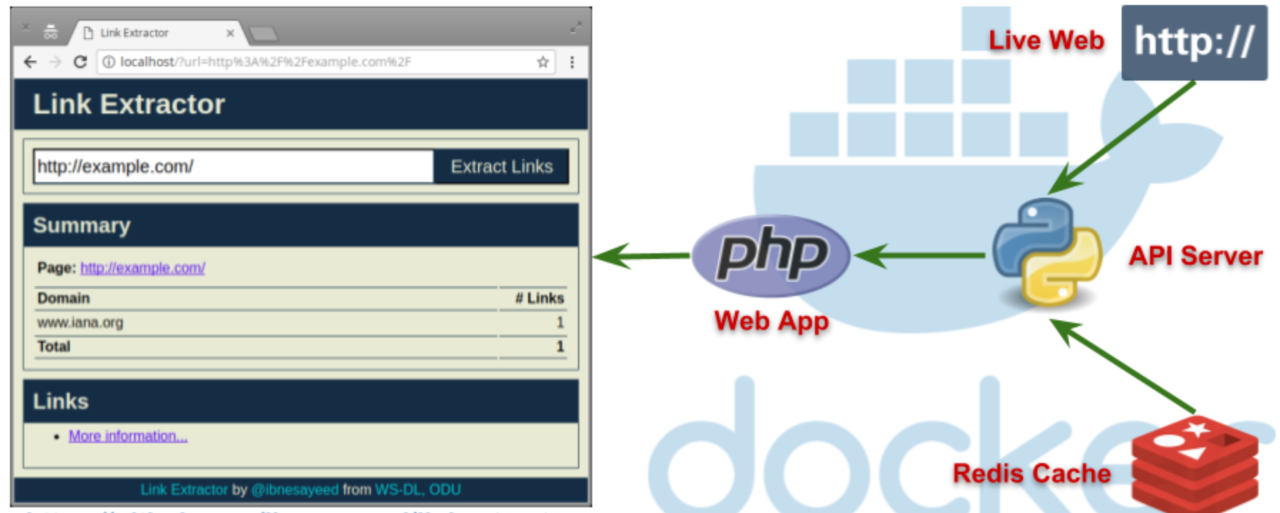
Vaja: Ekstraktor URL naslovov

Slide 68
Uporabni viri
https://github.com/veggiemonk/awesome-docker
https://pythonspeed.com/docker/
Develop with Docker

Slide 69

Kubernetes
Ljubljana, september 2021

Slide 70
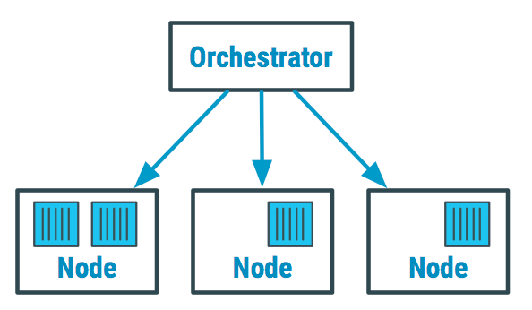
Orchestration
Containers give your microservice-based apps an ideal application deployment unit and self-contained execution environment.
need to deploy and manage hundreds or thousands of containers -> doing itmanually isn’t a scalable strategy.
Container orchestration automates the deployment, management, scaling, and networking of containers
Tools: Kubernetes, Docker Swarm, AWS Fargate
Source: https://devopedia.org/container-orchestration
Notes:
https://www.redhat.com/en/topics/automation/what-is-orchestration
https://www.redhat.com/en/topics/containers/what-is-container-orchestration

Slide 71


Kubernetes
https://kubernetes.io/
When your system grows, it becomes hard to manage all the components
Kubernetes is a portable, extensible, open-source platform for managing containerized workloads and services, that facilitates both declarative configuration and automation.
Rapidly growing ecosystem
Kubernetes originates from Greek, meaning helmsman or pilot.

Slide 72
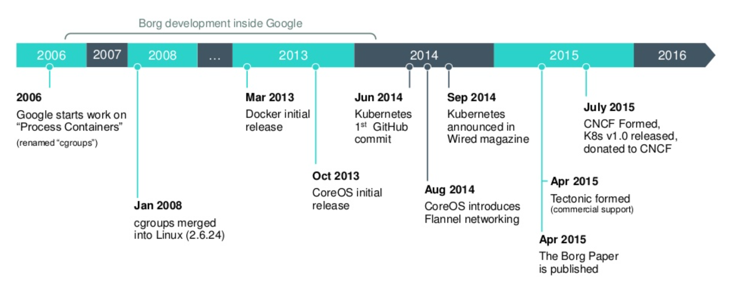
Origins
Google developed an internal system called Borg, that helped both application developers and system administrators manage those thousands of applications and services.
Borg and Omega were kept in secret for a whole decade.
In 2014 Google introduced Kubernetes, an open-source system based on the experience gained through Borg, Omega, and other internal Google systems.
Source: https://www.slideshare.net/egg9/kubernetes-introduction

Slide 73
Introduction
Kubernetes is a software system that allows you to easily deploy and manage containerized applications on top of it.
Relies on the features of Linux containers
Apps run in containers, they don’t affect other apps running on same server -> run applications for completely different organizations on the same hardware
maintain complete isolation of hosted applications
Thousands of computer nodes as if all those nodes were a single, enormous computer
Deploying applications through Kubernetes is always the same.
Kubernetes can be thought of as an operating system for the cluster.

Slide 74
Glavne značilnosti
Omogoča deklarativen opis stanj z visokonivojskimi koncepti
Kontejnerje samodejno razporeja na ustrezne gostitelje
Skrbi za vnovični zagon kontejnerjev
Prerazporeja kontejnerje v primeru izpada
Preverja vitalnost kontejnerjev in poskrbi za njihovo odstranitev, če se ti ne odzivajo
Omogoča samodejno horizontalno skaliranje kontejnerjev
Omogoča odkrivanje storitev
Progresivno posodabljanje aplikaciji
Omogoča hranjenje in upravljanje varnostnih podatkov in konfiguracijo aplikaciji
Samodejni priklop podatkovnih shramb

Slide 75
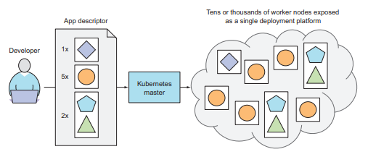
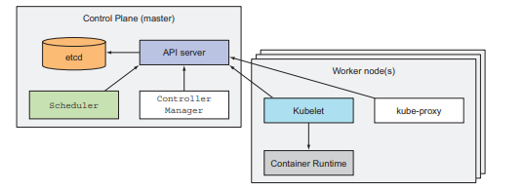
What Kubernetes does?
Master node and any number of worker nodes
Developer submits a list of apps to the master, Kubernetes deploys them to the cluster of worker nodes.
Vir: Marko Luksa - Kubernetes in Action-Manning Publications (2018)
Notes:
The developer can specify that certain apps must run together and Kubernetes will deploy them on the same worker node. Others will be spread around the cluster, but they can talk to each other in the same way, regardless of where they’re deployed.

Slide 76
Running an application in Kubernetes
package the application up into one or more container images
push those images to an image registry
post a description of your app to the Kubernetes API server
information such as the container image, how those components are related to each other, and which ones need to be run co-located
the API server processes your app’s description
the Scheduler schedules the specified groups of containers onto the available worker nodes
the Kubelet on those nodes then instructs the Container Runtime to pull the required container images and run the containers

Slide 77
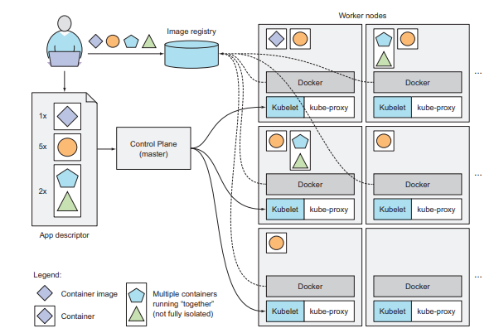
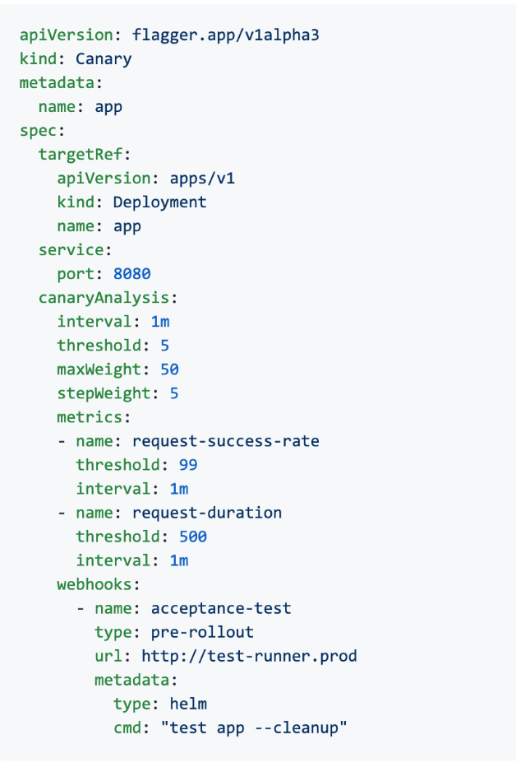
Vir: Marko Luksa - Kubernetes in Action-Manning Publications (2018)
Notes:
- Povemo za yaml

Slide 78

Benefits of using Kubernetes
Simplifying application deployment
exposes all its worker nodes as a single deployment platform
Achieving better utilization of hardware
Health checking and self-healing
Automatic scaling
Simplifying application development
Notes:
SIMPLIFYING APPLICATION DEPLOYMENT
Because Kubernetes exposes all its worker nodes as a single deployment platform, application developers can start deploying applications on their own and don’t need to know anything about the servers that make up the cluster. In essence, all the nodes are now a single bunch of computational resources that are waiting for applications to consume them. A developer doesn’t usually care what kind of server the application is running on, as long as the server can provide the application with adequate system resources. Certain cases do exist where the developer does care what kind of hardware the application should run on. If the nodes are heterogeneous, you’ll find cases when you want certain apps to run on nodes with certain capabilities and run other apps on others. For example, one of your apps may require being run on a system with SSDs instead of HDDs, while other apps run fine on HDDs. In such cases, you obviously want to ensure that particular app is always scheduled to a node with an SSD. Without using Kubernetes, the sysadmin would select one specific node that has an SSD and deploy the app there. But when using Kubernetes, instead of selecting a specific node where your app should be run, it’s more appropriate to tell Kubernetes to only choose among nodes with an SSD. You’ll learn how to do that in chapter 3

Slide 79
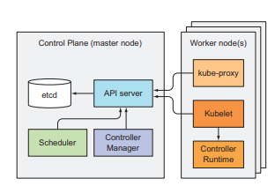
Kubernetes - architecture
A Kubernetes cluster is split into two parts:
The Kubernetes Control Plane
The (worker) nodes
The Control Plane is what controls and makes the whole cluster function.
The task of running your containers is up to the components running on each worker node.
Source: Marko Luksa - Kubernetes in Action-Manning Publications (2018)

Slide 80
Control Plane Components
etcd distributed persistent storage (etcd)
API server (kube-apiserver)
Scheduler (kube-scheduler)
Controller Manager (kube-controller-manager)
cloud-controller-manager
Worker Node Components
Kubelet
Kubernetes Service Proxy (kube-proxy)
Container Runtime (Docker, rkt, or others)
Add-on Components
DNS
Web UI (Dashboard)
Container Resource Monitoring
Cluster-level Logging
An Ingress controller
Notes:
https://kubernetes.io/docs/concepts/overview/components/

Slide 81
Kubernetes Components
A Kubernetes cluster consists of a set of worker machines, called nodes, that run containerized applications. Every cluster has at least one worker node.
In production environments, the control plane usually runs across multiple computers and a cluster usually runs multiple nodes, providing fault-tolerance and high availability.
The previously mentioned components all run as individual processes.
To get all the features Kubernetes provides, all these components need to be running.

Slide 82
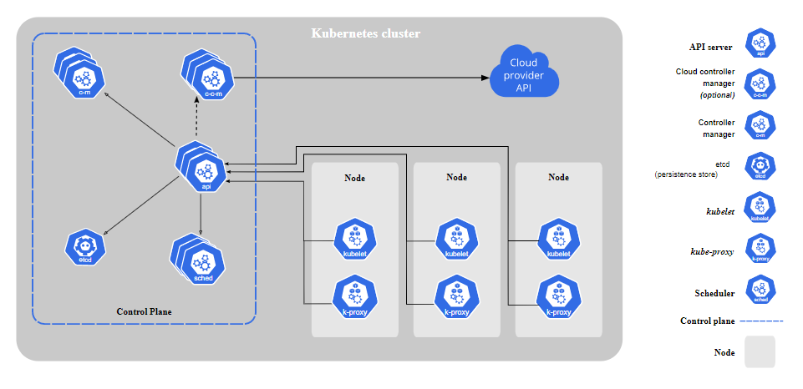
Vir: Kubernetes Components (https://kubernetes.io/docs/concepts/overview/components/)

Slide 83

etcd
consistent and highly-available key value store used as Kubernetes' backing store for all cluster data
you can run more than one etcd instance to provide both high availability
the number of etcd instances should be an odd number
the only component that talks to etcd directly is the Kubernetes API server
a more robust optimistic locking system
Validation
much simpler to replace it in the future
is the only place Kubernetes stores cluster state and metadata
Notes:
The only component that talks to etcd directly is the Kubernetes API server. All other components read and write data to etcd indirectly through the API server. This brings a few benefits, among them a more robust optimistic locking system as well as validation; and, by abstracting away the actual storage mechanism from all the other components, it’s much simpler to replace it in the future.

Slide 84
API server (kube-apiserver)
a control plane component that exposes the Kubernetes API
API server is the front end for the Kubernetes control plane
kube-apiserver is designed to scale horizontally (run several instances of kube-apiserver and balance traffic between those instances)
Kubernetes system components communicate only with the API server
used by all other components and by clients
it provides a CRUD (Create, Read, Update, Delete) interface for querying and modifying the cluster state over a RESTful API
performs validation of those objects, so clients can’t store improperly configured objects

Slide 85
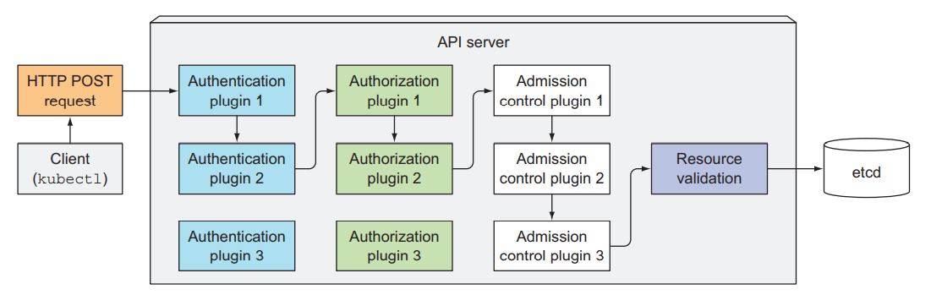
One of the API server’s clients is the command-line tool kubectl
creating a resource from a JSON file and make an HTTP POST request
authenticate the client sending the request (determines who is sending the request)
authorize whether the authenticated user can perform the requested action on the requested resource
validating and/or modifying the resource in the request with admission control plugins
API server then validates the object
Vir: Marko Luksa - Kubernetes in Action-Manning Publications (2018)

Slide 86
Scheduler (kube-scheduler)
watches for newly created Pods with no assigned node, and selects a node for them to run on
the Scheduler doesn’t instruct the selected node -> update the pod definition through the API server -> API server then notifies the Kubelet
you can write your own scheduling component and use that instead
Factors taken into account for scheduling decisions include:
individual and collective resource requirements,
hardware/software/policy constraints,
affinity and anti-affinity specifications,
data locality,
inter-workload interference,
deadlines
Notes:
https://kubernetes.io/docs/concepts/scheduling-eviction/kube-scheduler/
only a single instance of the Scheduler and the Controller Manager may be active at a given time—with the others in standby mode.

Slide 87
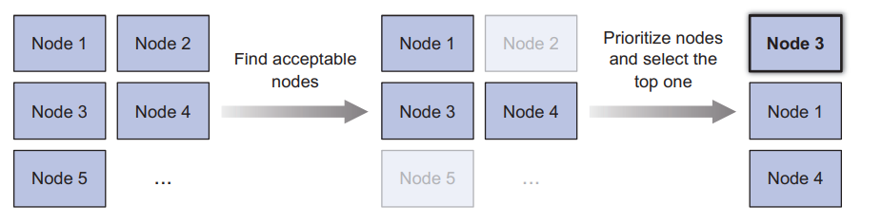
The default scheduling algorithm:
Filtering the list of all nodes to obtain a list of acceptable nodes the pod can be scheduled to
Prioritizing the acceptable nodes and choosing the best one.
If multiple nodes have the highest score, round-robin is used to ensure pods are deployed across all of them evenly.
Source: Marko Luksa - Kubernetes in Action-Manning Publications (2018)
Notes:
To determine which nodes are acceptable for the pod, the Scheduler passes each node through a list of configured predicate functions. These check various things such as ○ Can the node fulfill the pod’s requests for hardware resources? You’ll learn how to specify them in chapter 14. ○ Is the node running out of resources (is it reporting a memory or a disk pressure condition)? ○ If the pod requests to be scheduled to a specific node (by name), is this the node? ○ Does the node have a label that matches the node selector in the pod specification (if one is defined)? ○ If the pod requests to be bound to a specific host port (discussed in chapter 13), is that port already taken on this node or not? ○ If the pod requests a certain type of volume, can this volume be mounted for this pod on this node, or is another pod on the node already using the same volume? ○ Does the pod tolerate the taints of the node? Taints and tolerations are explained in chapter 16. ○ Does the pod specify node and/or pod affinity or anti-affinity rules? If yes, would scheduling the pod to this node break those rules? This is also explained in chapter 16

Slide 88
Controller Manager (kube-controller-manager)
Control Plane component that runs controller processes.
Logically, each controller is a separate process, but to reduce complexity, they are all compiled into a single binary and run in a single process.
The list of these controllers includes the:
Replication Manager (a controller for ReplicationController resources)
ReplicaSet, DaemonSet, and Job controllers
Deployment controller
StatefulSet controller
Node controller
Service controller
Endpoints controller
Namespace controller
PersistentVolume controller
Notes:
https://kubernetes.io/docs/concepts/architecture/controller/

Slide 89
there’s a controller for almost every resource you can create
Resources are descriptions of what should be running in the cluster
How ReplicationController works?
They watch the API server for changes to resources
each change that may affect the desired replica count or the number of matched pods
Creates new Pod manifests, posts them to the API server
lets the Scheduler and the Kubelet do their job of scheduling and running the pod
The Replication Manager performs its work by manipulating Pod API objects through the API server. This is how all controllers operate.
They don’t communicate with the Kubelets directly -> they don’t even know Kubelets exist

Slide 90
cloud-controller-manager
A Kubernetes control plane component that embeds cloud-specific control logic.
lets you link your cluster into your cloud provider's API
only runs controllers that are specific to your cloud provider
If you are running Kubernetes on your own premises, the cluster does not have a cloud controller manager
The following controllers can have cloud provider dependencies:
Node controller: For checking the cloud provider to determine if a node has been deleted in the cloud after it stops responding
Route controller: For setting up routes in the underlying cloud infrastructure
Service controller: For creating, updating and deleting cloud provider load balancers

Slide 91
Kubelet
An agent that runs on each node in the cluster. It makes sure that containers are running in a Pod.
The kubelet doesn't manage containers which were not created by Kubernetes.
Run pods based on:
pod manifests from the API server
pod manifest files in a specific local directory
This feature is used to run the containerized versions of the Control Plane components as pods

Slide 92
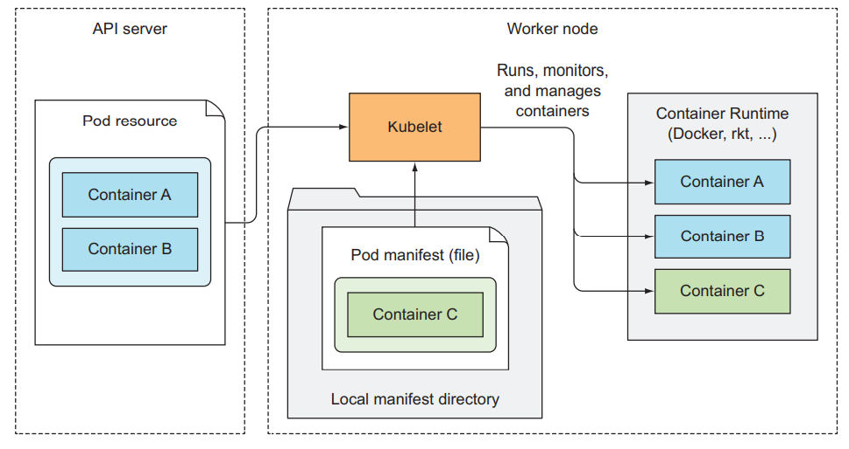
Source: Marko Luksa - Kubernetes in Action-Manning Publications (2018)

Slide 93
How is kubelet working?
initial job is to register the node it’s running on by creating a Node resource in the API server
continuously monitor the API server for Pods that have been scheduled to the node
start the pod’s containers
It does this by telling the configured container runtime to run a container from a specific container image
constantly monitors running containers
reports their status, events, and resource consumption to the API server
runs the container liveness probes, restarting containers when the probes fail
it terminates containers when their Pod is deleted from the API server and notifies the server that the pod has terminated

Slide 94
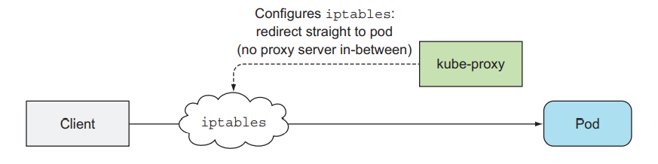
Kubernetes Service Proxy (kube-proxy)
kube-proxy is a network proxy that runs on each node in your cluster, implementing part of the Kubernetes Service concept.
Its purpose is to make sure clients can connect to the services you define through the Kubernetes API.
When a service is backed by more than one pod, the proxy performs load balancing across those pods.
kube-proxy maintains network rules on nodes. These network rules allow network communication to your Pods from network sessions inside or outside of your cluster.
kube-proxy uses the operating system packet filtering layer if there is one and it's available. Otherwise, kube-proxy forwards the traffic itself.
Source: Marko Luksa - Kubernetes in Action-Manning Publications (2018)
Notes:
https://betterprogramming.pub/k8s-a-closer-look-at-kube-proxy-372c4e8b090
https://www.tigera.io/blog/comparing-kube-proxy-modes-iptables-or-ipvs/

Slide 95
Container Runtimes
You need to install a container runtime into each node in the cluster so that Pods can run there.
The Open Container Initiative (OCI) has successfully standardized the concept of a container and container image in order to guarantee interoperability between runtimes
Kubernetes has added a Container Runtime Interface (CRI) to allow container runtimes to be pluggable underneath the Kubernetes orchestration layer
Common container runtimes with Kubernetes:
containerd
CRI-O
Docker (deprecated)
Notes:
https://www.infoq.com/articles/container-runtimes-kubernetes/
https://kubernetes.io/docs/setup/production-environment/container-runtimes/
https://kubernetes.io/blog/2016/12/container-runtime-interface-cri-in-kubernetes/

Slide 96

K3s - Lightweight Kubernetes
K3s is a fully compliant Kubernetes distribution with the following enhancements:
Packaged as a single binary (all Kubernetes control plane components is encapsulated in a single binary and process).
Lightweight storage backend.
Wrapped in simple launcher that handles a lot of the complexity of TLS and options.
Secure by default with reasonable defaults for lightweight environments.
Added powerful features: a local storage provider, a service load balancer, a Helm controller, and the Traefik ingress controller.

Slide 97
Why Use K3s
Perfect for Edge
highly available, certified Kubernetes distribution designed for production workloads in unattended, resource-constrained, remote locations or inside IoT appliances
Simplified & Secure
K3s is packaged as a single <40MB binary that reduces the dependencies and steps needed to install, run and auto-update a production Kubernetes cluster
Optimized for ARM
Both ARM64 and ARMv7 are supported with binaries and multiarch images available for both (e.g. Raspberry Pi).

Slide 98



Usage
Edge
IoT
CI
Development
ARM
Embedding K8s
Learning
Notes:
https://sum-tech.de/wp-content/uploads/2020/03/photo_2020-03-06_15-39-40-225x300.jpg
https://media.kasperskycontenthub.com/wp-content/uploads/sites/43/2018/09/18085355/abstract-iot-1000x600.jpg
https://forum.huawei.com/enterprise/en/data/attachment/forum/202104/30/020806ifrefr5ez7rnvrjx.png?edge%203%20ieee.png

Slide 99

Architecture
Vir: https://k3s.io/images/how-it-works-k3s.svg

Slide 100
Single-server Setup with an Embedded DB
A server node is defined as a machine (bare-metal or virtual) running the k3s server command.
A worker node is defined as a machine running the k3s agent command.
Cluster that has a single-node K3s server with an embedded SQLite database
Each agent node is registered to the same server node.
A K3s user can manipulate Kubernetes resources by calling the K3s API on the server node.

Slide 101

Vir: https://rancher.com/docs/img/rancher/k3s-architecture-single-server.png

Slide 102
High-Availability K3s Server with an External DB
Where uptime of the Kubernetes control plane is critical, you can run K3s in an HA configuration.
An HA K3s cluster is comprised of:
Two or more server nodes that will serve the Kubernetes API and run other control plane services
An external datastore - etcd3, MySQL, Postgres (as opposed to the embedded SQLite datastore used in single-server setups)

Slide 103

Vir: https://rancher.com/docs/img/rancher/k3s-architecture-ha-server.png

Slide 104
Installation
K3s provides an installation script that is a convenient way to install it as a service on systemd or openrc based systems. This script is available at https://get.k3s.io. To install K3s using this method, just run:
curl -sfL https://get.k3s.io | K3S_KUBECONFIG_MODE=644 sh -
The K3s service will be configured to automatically restart after node reboots or if the process crashes or is killed
Additional utilities will be installed, including kubectl, crictl, ctr, k3s-killall.sh, and k3s-uninstall.sh
A kubeconfig file will be written to /etc/rancher/k3s/k3s.yaml and the kubectl installed by K3s will automatically use it
Notes:
https://rancher.com/docs/k3s/latest/en/quick-start/

Slide 105

First app
Vir: Marko Luksa - Kubernetes in Action-Manning Publications (2018)

Slide 106

Pods
Pod is a co-located group of containers and represents the basic building block in Kubernetes.
You always deploy and operate on a pod of containers.
it’s common for pods to contain only a single container
When a pod does contain multiple containers, all of them are always run on a single worker node
Vir: Marko Luksa - Kubernetes in Action-Manning Publications (2018)

Slide 107
Containers are designed to run only a single process per container
You need to run each process in its own container. That’s how Docker and Kubernetes are meant to be used.
A pod of containers allows you to run closely related processes together and provide them with (almost) the same environment as if they were all running in a single container, while keeping them somewhat isolated
they all share the same hostname and network interfaces
Can run under the same IPC namespace
the file system of each container is fully isolated from other containers

Slide 108


Containers in a pod share the same IP address and port space
processes running in containers of the same can’t bind to the same port numbers
Container can communicate with other containers in the same pod through localhost
All pods in a Kubernetes cluster reside in a single flat, shared, network-address space.
Vir: Marko Luksa - Kubernetes in Action-Manning Publications (2018)

Slide 109
Organizing containers across pods
run only one application in each pod
pods have almost no resource overhead
Example: simple system composed of a front-end web server and a back-end database
you shouldn’t run them in the same pod
they can easily communicate over the network
improving the utilization of your hardware
horizontal scaling (basic unit of scaling) –> Kubernetes doesn’t replicate containers within a pod. It replicates the entire pod
different components have different scaling requirements
Relational databases, usually can’t be scaled
Decide when to place containers in a single pod:
Do these containers have to run on the same host? yes
Do I want to manage them as a single unit? yes
Do they form a unified whole instead of being independent components? yes
Do they have to be scaled together? yes
Can a single node meet their combined resource needs? yes

Slide 110

Vir: Marko Luksa - Kubernetes in Action-Manning Publications (2018)

Slide 111


Sidecar containers
multiple containers into a single pod -> when the application consists of one main process and one or more complementary processes
sidecar containers include log rotators and collectors, data processors, communication adapters, and others
Vir: Marko Luksa - Kubernetes in Action-Manning Publications (2018)
Notes:
Vedno strmimo k temu, da kontejnerje zaženemo v ločenih podih.

Slide 112

V splošnem strokov nikoli ne kreiramo neposredno.
Vir: Marko Luksa - Kubernetes in Action-Manning Publications (2018)
Notes:
Kreiramo jih z uporabo namestitvenih enot tipa namestitev (Deployment), ki doprinesejo:
•zmožnost samodejne vzpostavitve ob izpadu stroka,
•upravljanje replik in
•“rollout” namestitve in posodobitve.

Slide 113

Primer: namestitev stroka
Namestitev
kubectl apply -f kubia-manual.yaml
Pridobitev informaciji o strokih
kubectl get pod kubia-manual -o yaml
kubectl get pods
Pridobitev dnevnikov (logiranja)
kubectl logs kubia-manual
Pošiljanje zahtevkov na strok
Vir: Marko Luksa - Kubernetes in Action-Manning Publications (2018)

Slide 114

Labels (označbe)
Omogočajo organizacijo Kubernetes objektov
Poljuben par ključ-vrednost
Omogočajo izbiranje gostitelja za namestitev
Vir: Marko Luksa - Kubernetes in Action-Manning Publications (2018)
Notes:
For example, with microservices architectures, the number of deployed microservices
can easily exceed 20 or more. Those components will probably be replicated
(multiple copies of the same component will be deployed) and multiple versions or
releases (stable, beta, canary, and so on) will run concurrently. This can lead to hundreds
of pods in the system. Without a mechanism for organizing them, you end up
with a big, incomprehensible mess, such as the one shown in figure 3.6. The figure
shows pods of multiple microservices, with several running multiple replicas, and others
running different releases of the same microservice.

Slide 115

Vir: Marko Luksa - Kubernetes in Action-Manning Publications (2018)

Slide 116
Ustavitev in odstranjevanje strokov
Odstranjevanje stroka po imenu:
kubectl delete pod <POD_NAMES>
Odstranjevanje s pomočjo oznake Label
kubectl delete pod <POD_NAMES> -l <KEY:VALUE>
Odstranitev vseh virov (razen objekta Secret)
kubectl delete all –all

Slide 117
Zdravje strokov
Strokov v praksi ne uporabljamo direktno -> uporabimo drugačne tipe virov (ReplicationControllers, Deployments)
Stroki niso odporni na:
napake v času razporejanja (scheduling)
izpad gostitelja,
In drugih napak zaradi vzdrževanja ali pomanjkanja virov.
V primeru da kontejner v stroku odpove, ga Kubelet ponovno zažene
Nekatere aplikacije nehajo delovati, brez da bi se proces zaustavil (memory leak, infinite loop, deadlock)
Moramo preveriti zdravje od zunaj

Slide 118
Liveness probes
Omogočajo preverjanje ali je kontejner še živ
Lahko jo definiramo za vsak kontejner posebej
Kubernetes periodično preverja stanje in ponovno zažene kontejner v primeru, da Liveness Probe ne zazna delovanja aplikacije
Obstajajo tudi Rediness probe (več o tem kasneje)
Omogočajo tri mehanizme zaznavanja:
HTTP GET probe
TCP Socket probe
Exec probe
V produkcijskih okoljih je praksa vedno definirati Liveness probe
Izpostavimo URL path /health -> preverimo notranji status vitalnih komponent aplikacije ob klicu
Potrebujemo mehanizem, ki poskrbi za zagon vseh strokov ob odpovedi gostitelja

Slide 119
ReplicationControllers (replikacijski nadzornik)
https://kubernetes.io/docs/concepts/workloads/controllers/replicationcontroller/
Replikacijski nadzornik (Replication Controller) zagotovi, da v nekem trenutku teče zahtevano število replik nekega stroka.
Če je strokov preveč, replikacijski nadzornik poskrbi za odstranitev odvečnih, če jih je premalo, poskrbi za zagon preostalih.
Stroki, ki jih ustvari replikacijski nadzornik, so samodejno nadomeščeni v primeru:
izpada zaradi napake pri delovanju,
da je strok pobrisan ali
je bil ustavljen.

Slide 120

Vir: Marko Luksa - Kubernetes in Action-Manning Publications (2018)

Slide 121

Constantly monitors the list of running pods and makes sure the actual number of pods of a “type” always matches the desired number
If too few such pods are running, it creates new replicas from a pod template.
If too few such pods are running, it creates new replicas from a pod template.
Vir: Marko Luksa - Kubernetes in Action-Manning Publications (2018)

Slide 122
Replica Set (replikacijski niz)
Replikacijski niz (RS) nadomešča replikacijski nadzornik (RC).
Večinoma jih ne kreiramo direktno, ampak z uporabo Deployment vira
https://kubernetes.io/docs/concepts/workloads/controllers/replicaset/
Replikacijski niz uporabimo v primeru:
ko imamo zahtevo, da v določenem trenutku teče določeno število podov,
ni potrebe po posodobitvah.
Razlika med RS in RC zajema
podporo za selector
RS podpira selector na osnovi set ov.
RC podpira selector le na osnovi enakosti
podporo za rolling update
V primeru potrebe je priporočena uporaba namestitvene enote tipa namestitev, ki za razliko od RS omogoča deklarativno nadgradnjo

Slide 123


DaemonSets
Run on each and every node in the cluster exactly one instance of the pod
Infrastructure-related pods that perform system-level operations (log collector, resource monitor…)
Source: Marko Luksa - Kubernetes in Action-Manning Publications (2018)
Notes:
Outside of Kubernetes, such processes would usually be started through system init scripts or the systemd daemon during node boot up.
If a node goes down, the DaemonSet doesn’t cause the pod to be created elsewhere.
But when a new node is added to the cluster, the DaemonSet immediately deploys a new pod instance to it.
A DaemonSet deploys pods to all nodes in the cluster, unless you specify that the pods should only run on a subset of all the nodes.

Slide 124

Primer: DaemonSet – SSD monitor
Želimo namestiti aplikacijo, ki monitorira SSD na vse tiste gostitelje, ki podpirajo SSD
Vir: Marko Luksa - Kubernetes in Action-Manning Publications (2018)

Slide 125

Jobs / CronJob
Allows you to run a pod whose container isn’t restarted when the process running inside finishes successfully.
In the event of a node failure, the pods on that node that are managed by a Job will be rescheduled to other nodes.
Jobs are useful for ad hoc tasks, where it’s crucial that the task finishes properly.
CronJob resource is useful for jobs that need to be run at a specific time in the future or repeatedly in the specified interval.
Source: Marko Luksa - Kubernetes in Action-Manning Publications (2018)

Slide 126
Service
Pods will usually respond to HTTP requests coming either from other pods inside the cluster or from clients outside the cluster.
Specifying the exact IP address or hostname of the server providing the service in the client’s configuration files wouldn’t work in Kubernetes:
Pods are ephemeral
Kubernetes assigns an IP address to a pod after the pod has been scheduled to a node and before it’s started
Horizontal scaling means multiple pods may provide the same service
To solve these problems, Kubernetes provides another resource type - Services
Notes:
https://kubernetes.io/docs/concepts/services-networking/service/

Slide 127

A Kubernetes Service is a resource you create to make a single, constant point of entry to a group of pods providing the same service (ClusterIP).
The IP address and port never change while the service exists.
Connections are routed to one of the pods backing that service.
Source: Marko Luksa - Kubernetes in Action-Manning Publications (2018)

Slide 128

Primer: ustvarjanje storitve
3 ReplicaSet stroki in Service
Vir: Marko Luksa - Kubernetes in Action-Manning Publications (2018)

Slide 129

Vir: Marko Luksa - Kubernetes in Action-Manning Publications (2018)

Slide 130

Primeri povezav:
večim strokom z enako storitvijo dodelimo enoten IP, ki je dosegljiv ostalim strokom znotraj gruče (ClusterIP)
izpostavimo storitve izven gruče preko storitve (externalName)
Izpostavimo storitev zunanjim odjemalcem:
Vir: Marko Luksa - Kubernetes in Action-Manning Publications (2018)

Slide 131
NodePort - Vsak gostitelj v gruči odpre vrata in usmeri zunanji promet iz teh vrat na konfigururano storitev. Storitev je na voljo na vratih vseh gostiteljev.
LoadBalancer - Storitev je dosegljiva preko namenskega load balancer-ja, zagotovljenega s strani ponudnika oblačnih storitev. Ta usmeri promet na vrata vseh gostiteljev v gruči.
Ingress - povsem drugačni mehanizem za izpostavljanje storitev preko enega naslova IP. Deluje na omrežnem nivoju 7 (HTTP) in ponuja več možnosti od ostalih storitev (omrežni nivo 4).

Slide 132

NodePort service
Vir: Marko Luksa - Kubernetes in Action-Manning Publications (2018)

Slide 133

LoadBalancer service
Vir: Marko Luksa - Kubernetes in Action-Manning Publications (2018)

Slide 134

Ingress
Vir: Marko Luksa - Kubernetes in Action-Manning Publications (2018)

Slide 135

Vir: Marko Luksa - Kubernetes in Action-Manning Publications (2018)

Slide 136


Deployment (namestitev)
https://kubernetes.io/docs/concepts/workloads/controllers/deployment/
omogoča deklarativno posodabljanje strokov in replikacijskih nizov
Možnosti posodobitev:
RollingUpdate (ko lahko imamo obe verziji aplikacije zagnane naenkrat)
Recreate (ko dve različni verziji aplikaciji ne morejo biti zagnani vzporedno)
Vir: Marko Luksa - Kubernetes in Action-Manning Publications (2018)

Slide 137

Vir: Marko Luksa - Kubernetes in Action-Manning Publications (2018)

Slide 138

Vir: Marko Luksa - Kubernetes in Action-Manning Publications (2018)

Slide 139
Upravljanje z viri
Brez omejitev lahko strok porabi vse vire, ki so mu na voljo
Specificiramo lahko CPU in pomnilnik za vsak kontejner v stroku
Specifikacija virov vpliva na razporejanje strokov
requests -> minimalna količina virov, ki jih strok potrebuje
limits -> maksimalna poraba virov za posamezen strok
V primeru, da na gostitelju ni dovolj virov glede na zahteve, scheduler ne bo namestil stroka na tega gostitelja

Slide 140


Vir: Marko Luksa - Kubernetes in Action-Manning Publications (2018)

Slide 141
Automatic scaling
Horizontalno vs vertikalno skaliranje
Možno ročno skaliranje preko replicas polja
Ni praktično ker moremo v naprej poznati obremenitev aplikaicje
Kubernetes omogoča avtomatsko skaliranje strokov ko zazna povečano CPU porabo
V oblačni infrastrukturi je možno tudi skaliranje gostiteljev
Horizontal pod autoscaling
skaliranje števila replik stroka
skaliramo lahko glede na CPU, pomnilnik, zahtevki na sekundo
Vertical pod autoscaling
ni še enostavne podpore
Horizontal scaling of cluster nodes
avtomatsko skaliranje števila gostiteljev

Slide 142

Vir: Marko Luksa - Kubernetes in Action-Manning Publications (2018)

Slide 143
Volumes
https://kubernetes.io/docs/concepts/storage/volumes/
Omogočajo kontejnerjem v stroku dostop do zunanjega prostora za shranjevanje podatkov in/ali deljenje prostora za shranjevanje med kontejnerji.
Privzeto si procesi znotraj stroka ne delijo datotečnega sistema.
Datotečni sistem izhaja iz slike kontejnerja.
Vir volumes je del stroka.

Slide 144


Vir: Marko Luksa - Kubernetes in Action-Manning Publications (2018)

Slide 145
Volume types
emptyDir - A simple empty directory used for storing transient data.
hostPath - Used for mounting directories from the worker node’s filesystem into the pod.
gitRepo - A volume initialized by checking out the contents of a Git repository.
nfs - An NFS share mounted into the pod.
gcePersistentDisk (Google Compute Engine Persistent Disk), awsElasticBlockStore (Amazon Web Services Elastic Block Store Volume), azureDisk (Microsoft Azure Disk Volume) - Used for mounting cloud provider-specific storage.
configMap, secret, downwardAPI - Special types of volumes used to expose certain Kubernetes resources and cluster information to the pod.

Slide 146

PersistentVolumes/PersistentVolumeClaims
Vir: Marko Luksa - Kubernetes in Action-Manning Publications (2018)

Slide 147

Vir: Marko Luksa - Kubernetes in Action-Manning Publications (2018)

Slide 148

Dynamic PersistentVolume provisioning
Vir: Marko Luksa - Kubernetes in Action-Manning Publications (2018)

Slide 149

Konfiguracija aplikaciji
Aplikacijo konfigururamo preko:
argumentov v ukazni vrstici
konfiguracijske datoteke
okoljskih spremenljivk
Vir za shranjevanje konfiguracije v Kubernetes-u imenujemo ConfigMap
Za shranjevanje občutljive konfiguracije Kubernetes ponuja vir Secret
Vir: Marko Luksa - Kubernetes in Action-Manning Publications (2018)

Slide 150


ConfigMap
https://kubernetes.io/docs/concepts/configuration/configmap/
Objekt, ki omogoča ločitev konfiguracijskih možnosti
Preslikava par ključ - vrednost
Lahko preslikamo tudi celotne konfiguracijske datoteke
Vir: Marko Luksa - Kubernetes in Action-Manning Publications (2018)

Slide 151
Secret
https://kubernetes.io/docs/concepts/configuration/secret/
Včasih imamo konfiguracijo z občutljivimi podatki, ki jo želimo želimo varno uporabiti
Preslikava par ključ - vrednost
Uporabimo jih na isti način kot ConfigMaps
https://kubernetes.io/docs/concepts/configuration/secret/#risks
A secret is only sent to a node if a Pod on that node requires it. The kubelet stores the secret into a tmpfs so that the secret is not written to disk storage. Once the Pod that depends on the secret is deleted, the kubelet will delete its local copy of the secret data as well.
On most Kubernetes distributions, communication between users and the API server, and from the API server to the kubelets, is protected by SSL/TLS. Secrets are protected when transmitted over these channels.

Slide 152

Vir: Marko Luksa - Kubernetes in Action-Manning Publications (2018)

Slide 153

Jobs / CronJob
https://kubernetes.io/docs/concepts/workloads/controllers/job/
Omogočajo zagon strokov z enim končnim opravilom
Primer: prenos in obdelava končne množice podatkov
Vir: Marko Luksa - Kubernetes in Action-Manning Publications (2018)

Slide 154
Nasveti
Web UI (Dashboard)
Connect a Front End to a Back End Using a Service
Unofficial Kubernetes

Slide 155
Vabljeni k sodelovanju!
info@ltfe.org
+386 1 476 8988
www.ltfe.org

